Slide 1
Greetings

Slide 2
Hello!

Slide 3
Hello!
Hi!

Slide 4
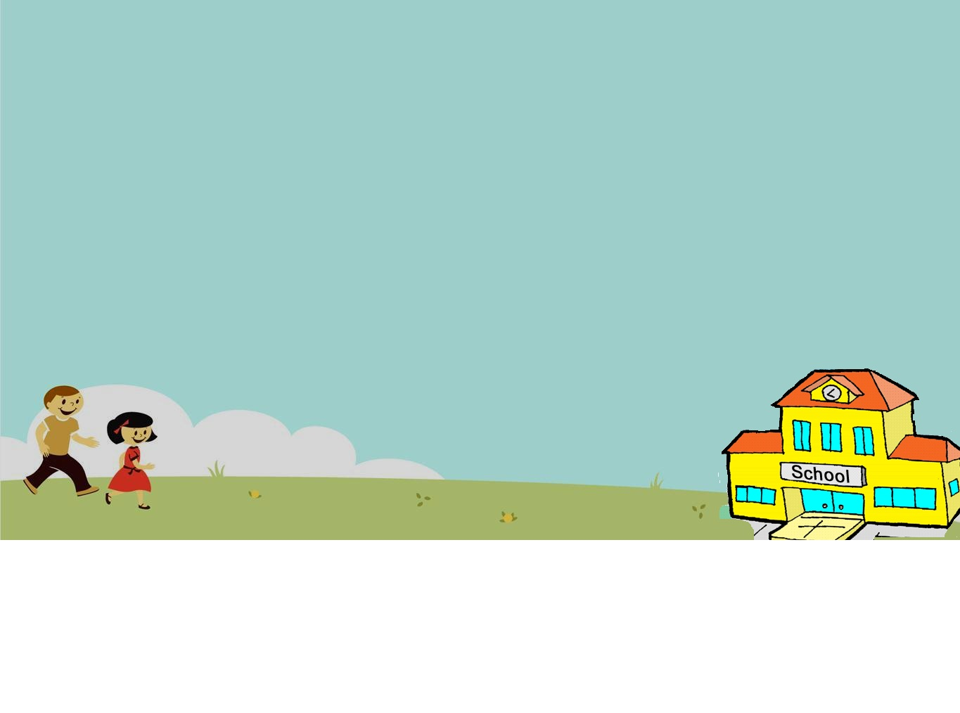
Good morning

Slide 5
Good afternoon

Slide 6
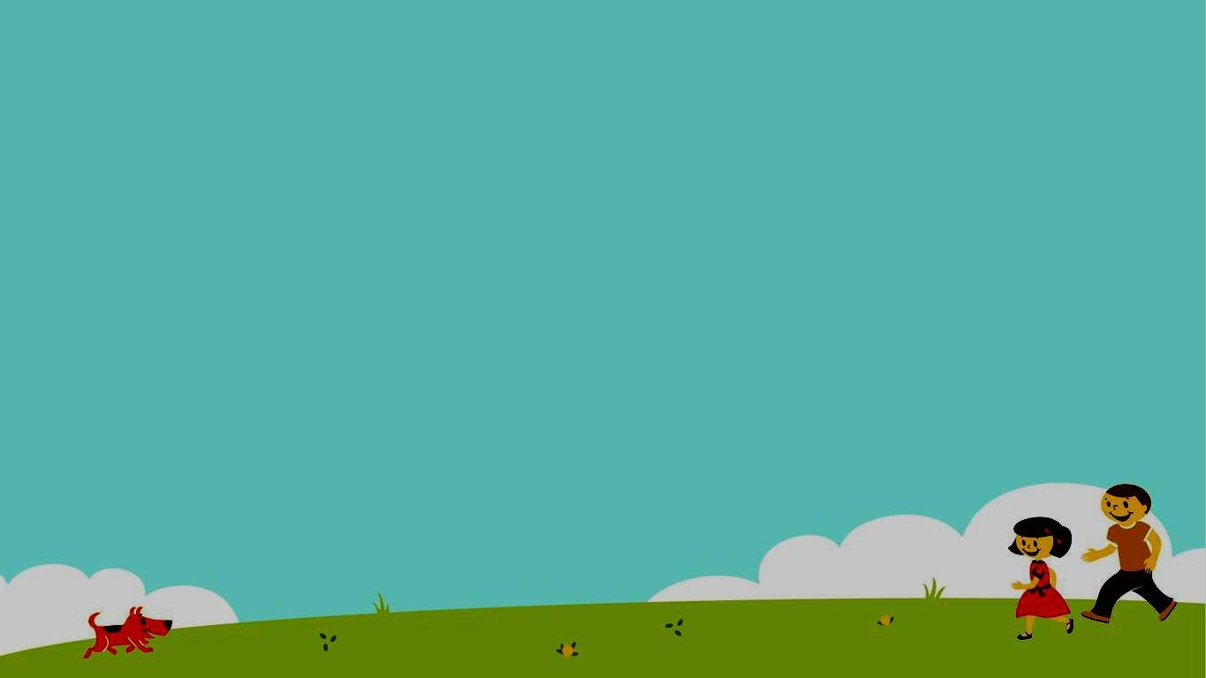
Good evening

Slide 7
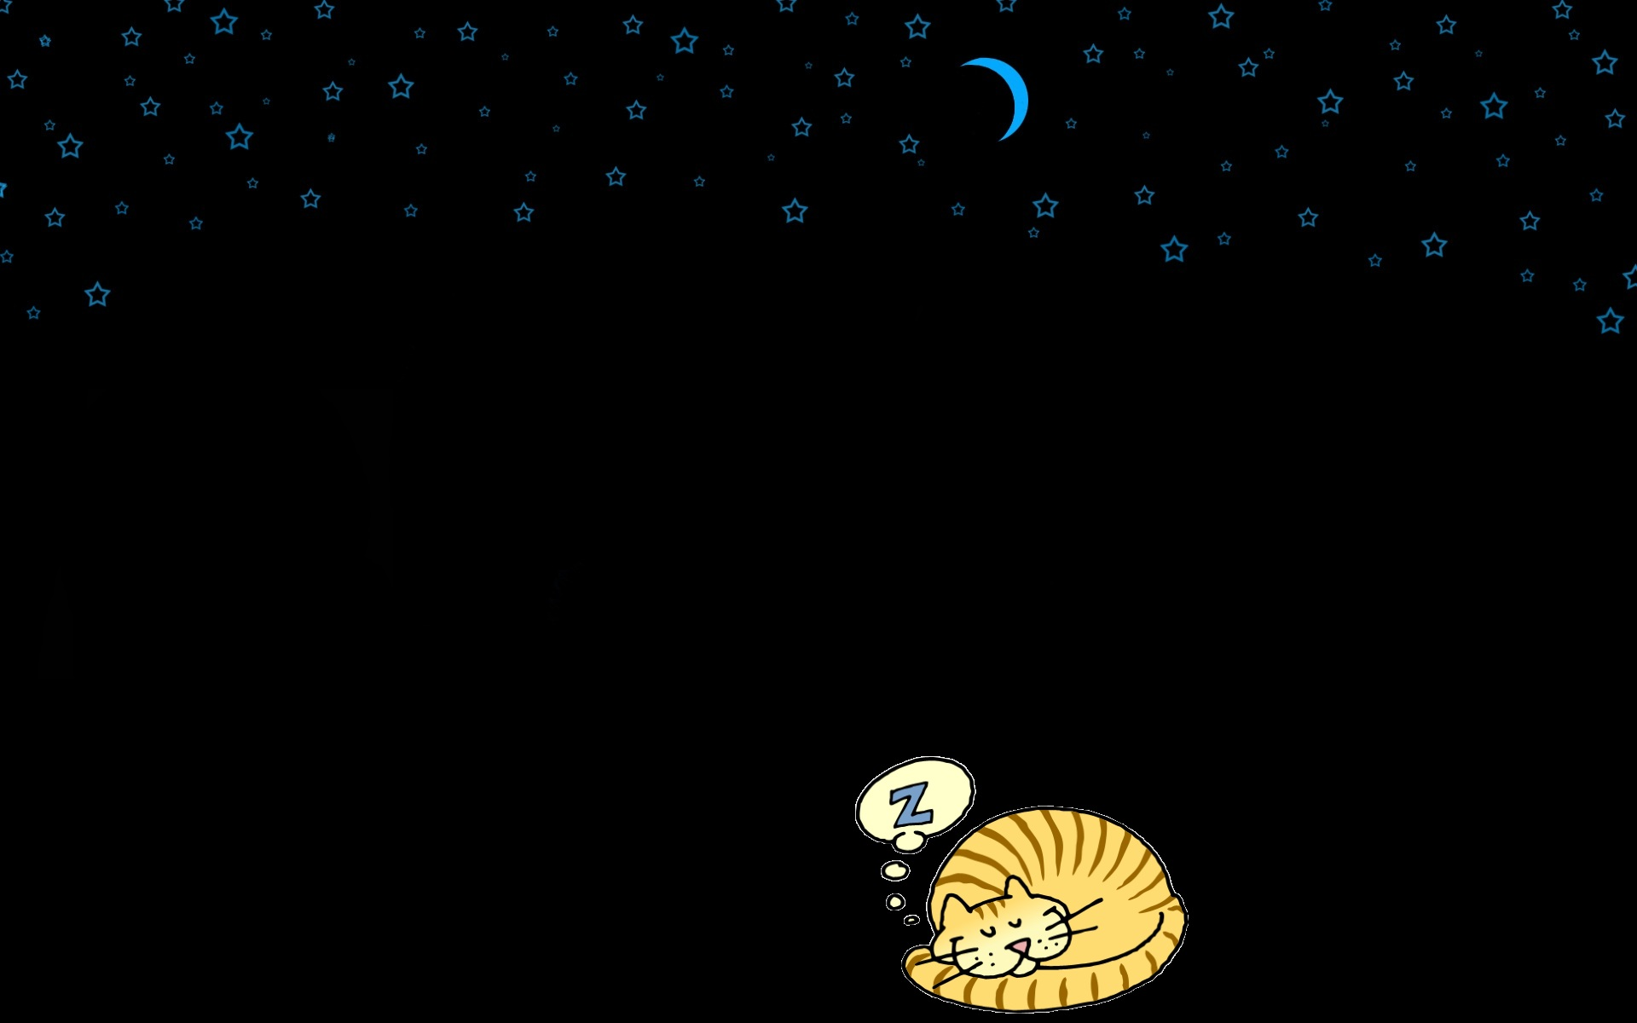
Good night

Slide 8
Goodbye! Bye Bye!

